Slide 1
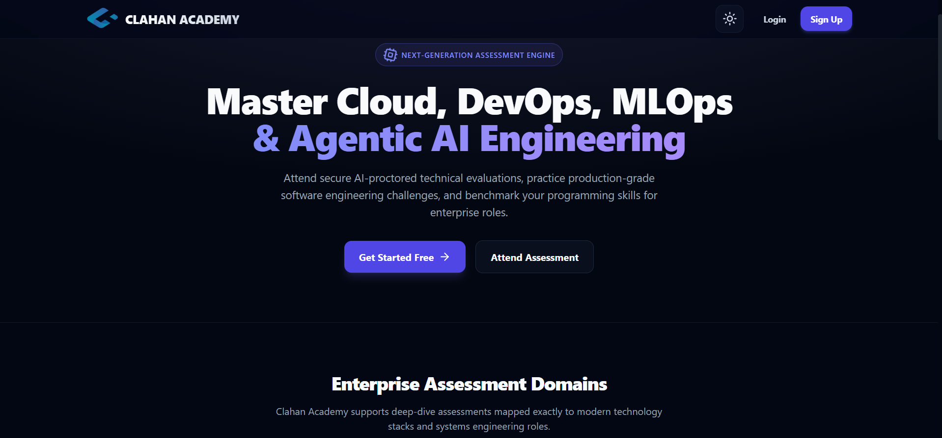
Clahan Academy
Cloud‑Native Microservices Platform & GitOps CI/CD Lifecycle

Slide 2
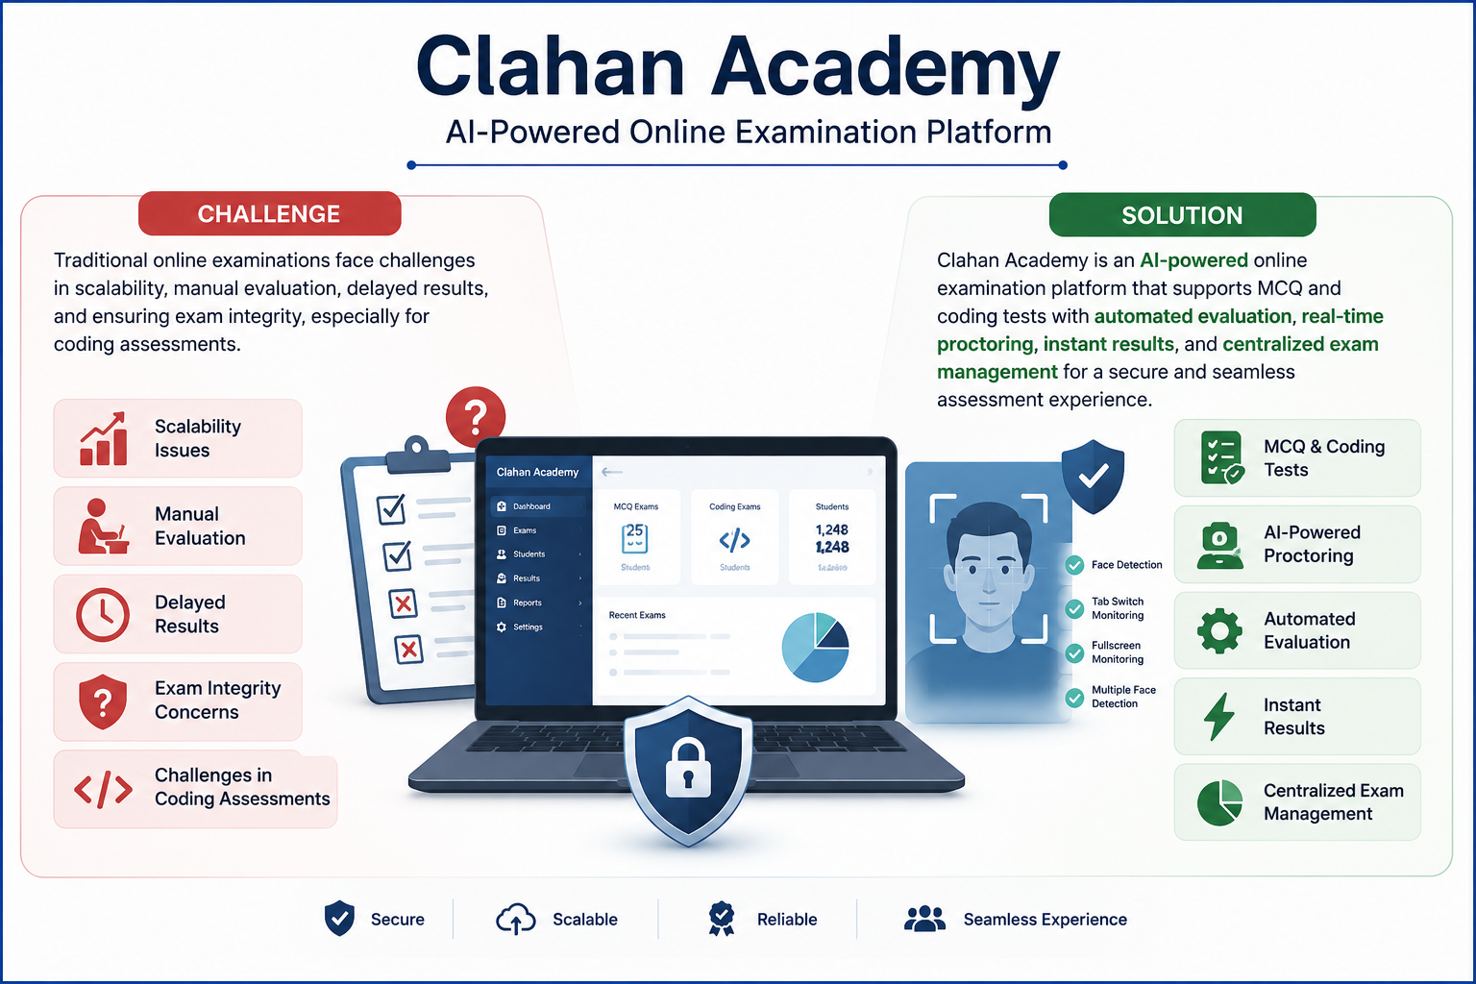
Why Clahan Academy

Slide 3
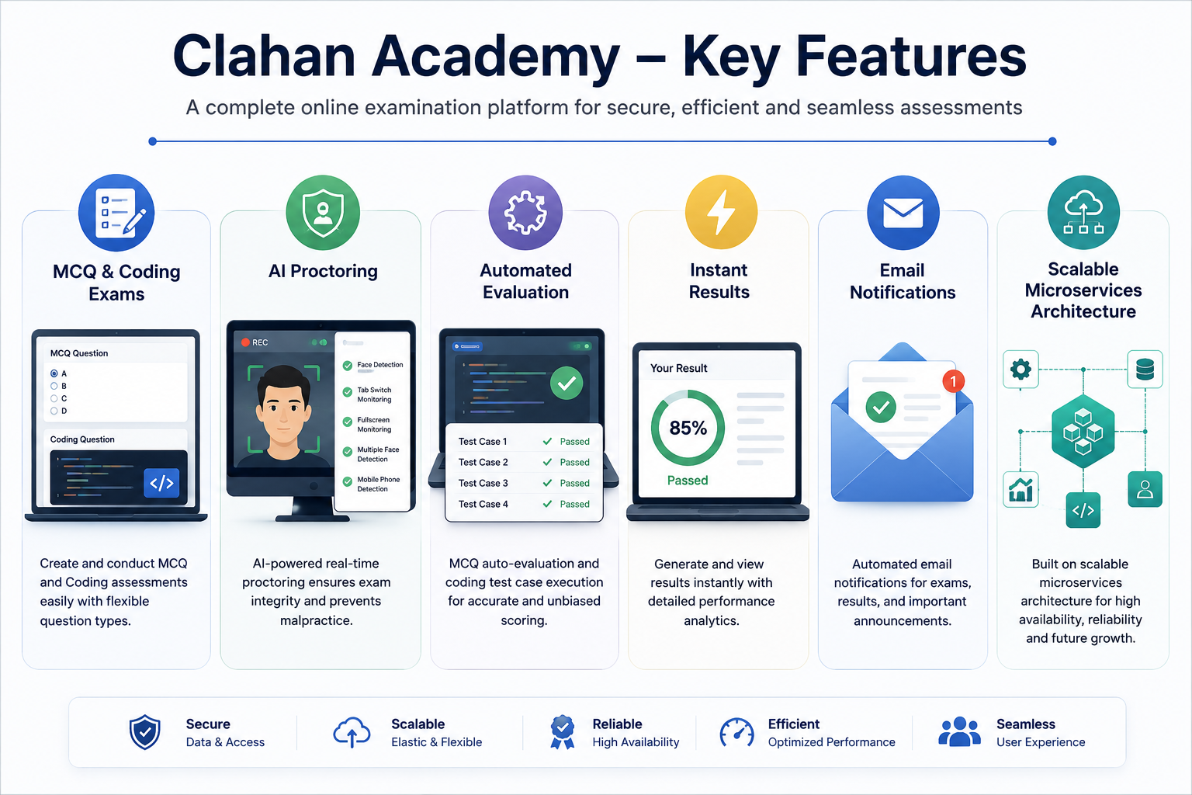

Slide 4
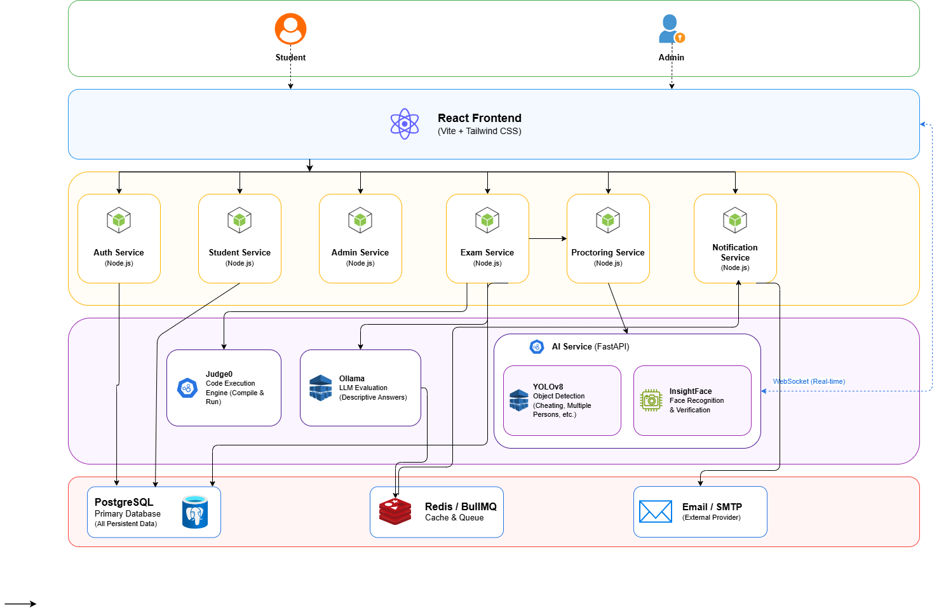
Application Architecture

Slide 5
Microservices Catalog Map
Vite / React Frontend
Auth Service
User interface, exam flows, editor & proctoring client.
Authentication, JWT, session validation, 2FA hooks.
Student / Admin / Exam Services
Proctoring Service
Core business logic and exam orchestration.
WebSocket handler for video frame ingestion.
AI Service
Notification Service
YOLOv8 & InsightFace inference on GPU nodes.
Background worker using BullMQ to send emails via SMTP.

Slide 6
Student Test‑Taking Journey (Step‑by‑Step)
1 • Login
1
Student authenticates via Auth Service; session recorded.
2
2 • Start Exam
Exam begins; WebSocket to Proctoring Service established; camera streams start.
3 • Code Work
3
Student writes code; submissions compiled/executed via Judge0 sandbox.
4
4 • Submit Answers
All answers sent to Exam Service (code & descriptive).
5 • Automated Grading
5
Ollama 'phi3' evaluates descriptive responses; exam scoring finalised.
6
6 • Notification
BullMQ enqueues the grade report; Notification Service emails results and stores audit records.

Slide 7

Real‑Time AI Proctoring — How it Works
Open WebSocket
Receive Frames
AI Analysis
Send Alerts
The browser opens a persistent WebSocket to the Proctoring Service; webcams stream frames to the AI Service which runs YOLOv8 and InsightFace on GPU nodes to detect anomalies and emit immediate alerts.

Slide 8
Sandboxed Programming Workspace
Students code inside the exam UI; submissions execute through an isolated judge API to ensure safety and
reproducibility.
Everything runs in constrained containers; results and logs are returned to the Exam Service for scoring and audit trails.
01
02
03
Editor
Judge0
Sandbox limits
In‑browser code editor with language support.
Exam Service forwards code to Judge0 for compilation/execution.
CPU/memory/time quotas prevent escapes or resource abuse.

Slide 9
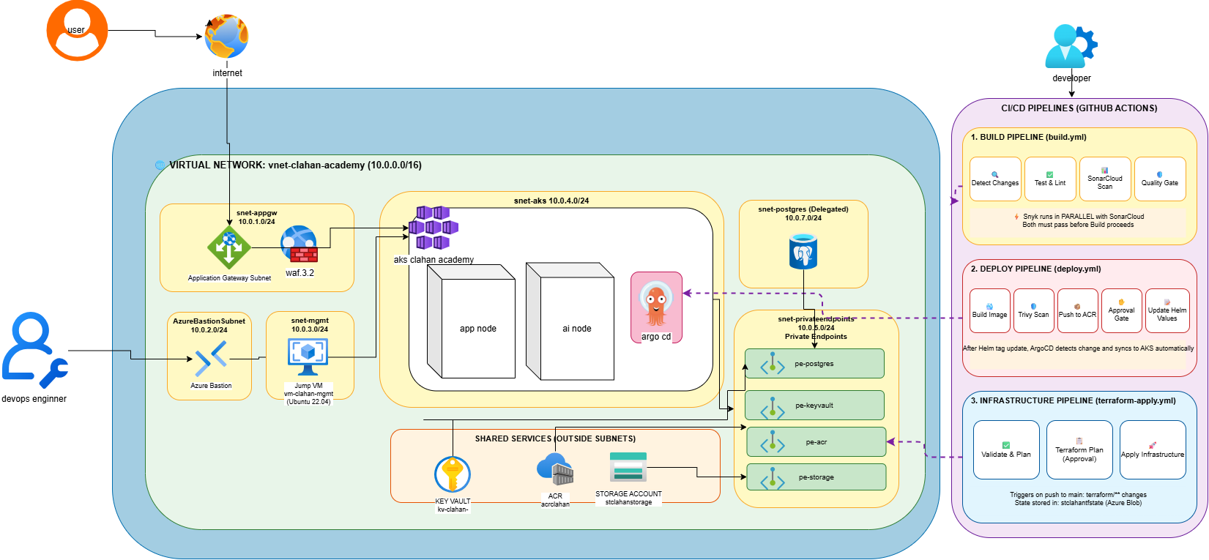
Clahan Academy Cloud Infrastructure Architecture

Slide 10
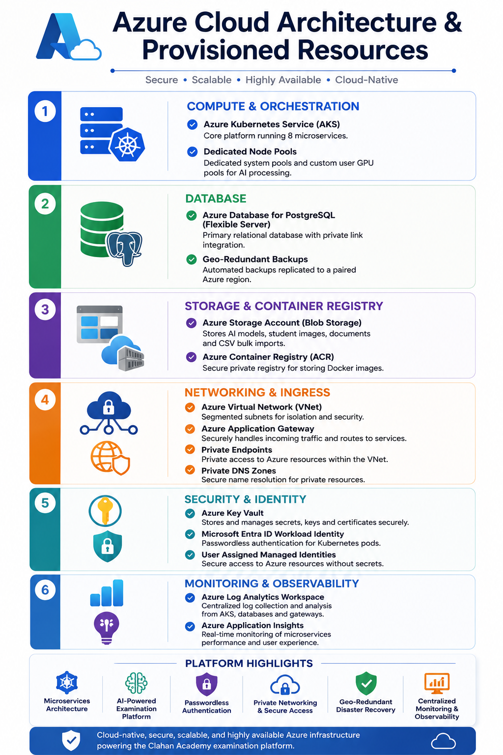
☁️ Azure Cloud Architecture & Provisioned Resources
Compute & Orchestration
Azure Kubernetes Service (AKS)
Dedicated Node Pools for Application & AI Workloads
Database
Azure Database for PostgreSQL (Flexible Server)
Geo-Redundant Backups Enabled
Storage & Container Registry
Azure Storage Account (Blob Storage)
Azure Container Registry (ACR)
Networking & Ingress
Azure Virtual Network (VNet)
Azure Application Gateway
Private Endpoints
Private DNS Zones
Security & Identity
Azure Key Vault
Microsoft Entra ID Workload Identity
User Assigned Managed Identities
Monitoring & Observability
Azure Log Analytics Workspace
Azure Application Insights

Slide 11
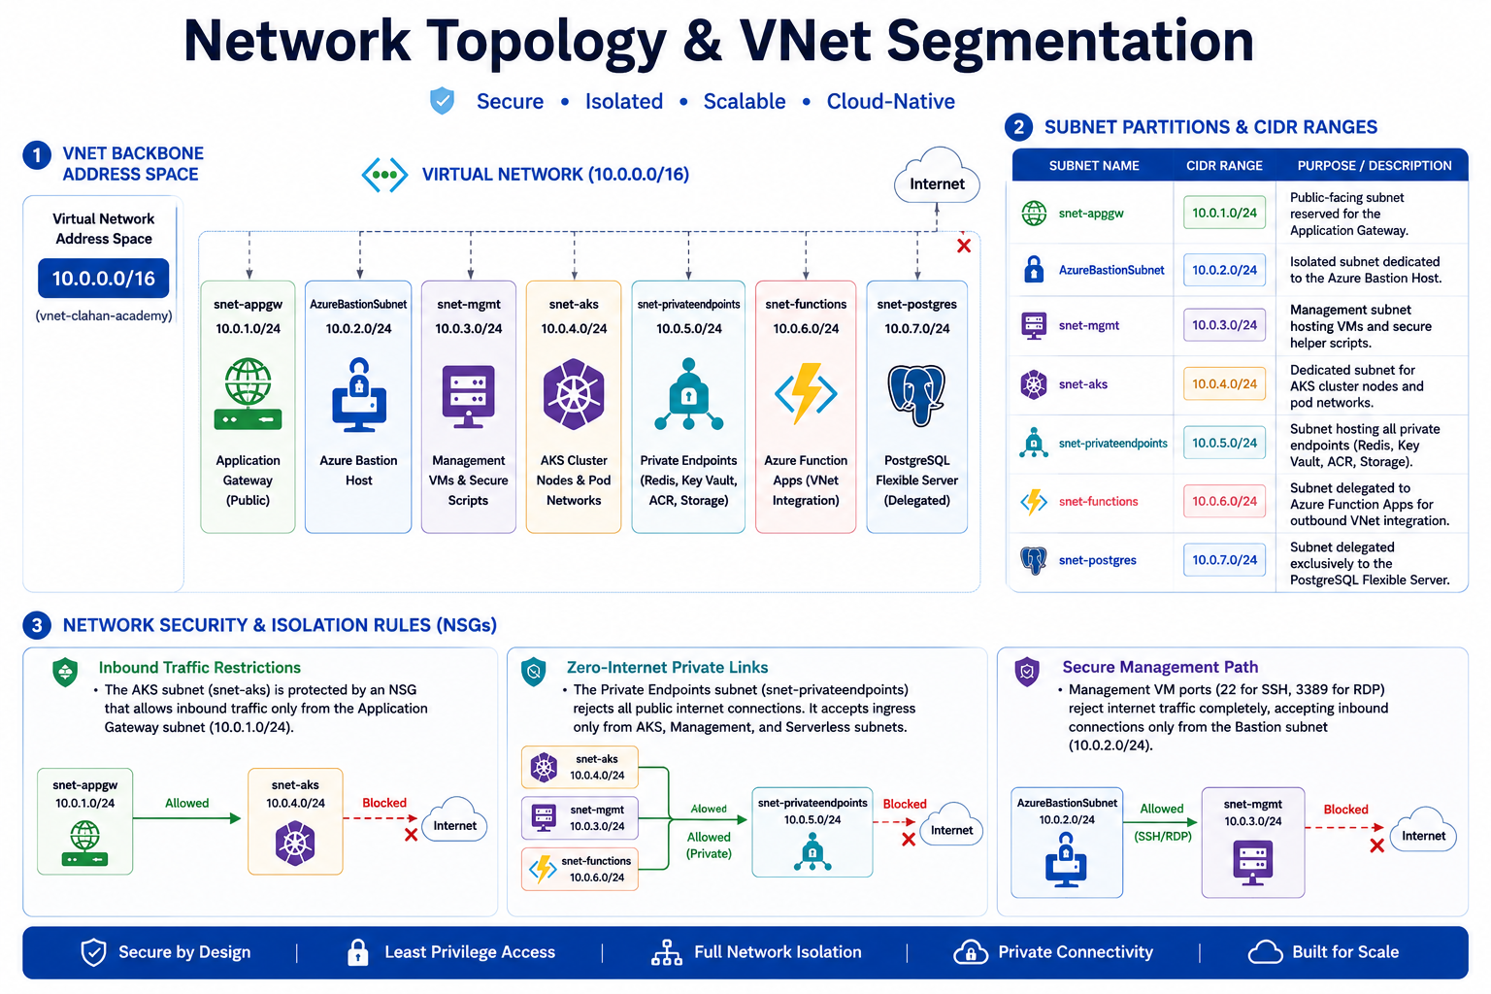

Slide 12



Traffic Flow & WAF Security
Path: HTTPS Client Requests
Decryption & Inspection
Forwarding
SSL terminates at the gateway using Key Vault certificates. Web Application Firewall (WAF) runs OWASP 3.2 protection in Prevention mode.
Gateway forwards clean HTTP traffic to internal kGateway (Envoy) on the private AKS subnet.
HTTPS client requests → Public IP (pip-appgw) → App Gateway v2

Slide 13
Infrastructure as Code (Terraform)
1
2
Modular Setup
Remote Backend
Code is divided into dedicated folders (networking, aks, postgres, keyvault, storage, identity)
Terraform state is stored securely in an Azure Storage Account container with blob leases for concurrency locking
3
Parameters
100% dry variables, tfvars files, and strict tagging conventions (Environment & Owner)

Slide 14
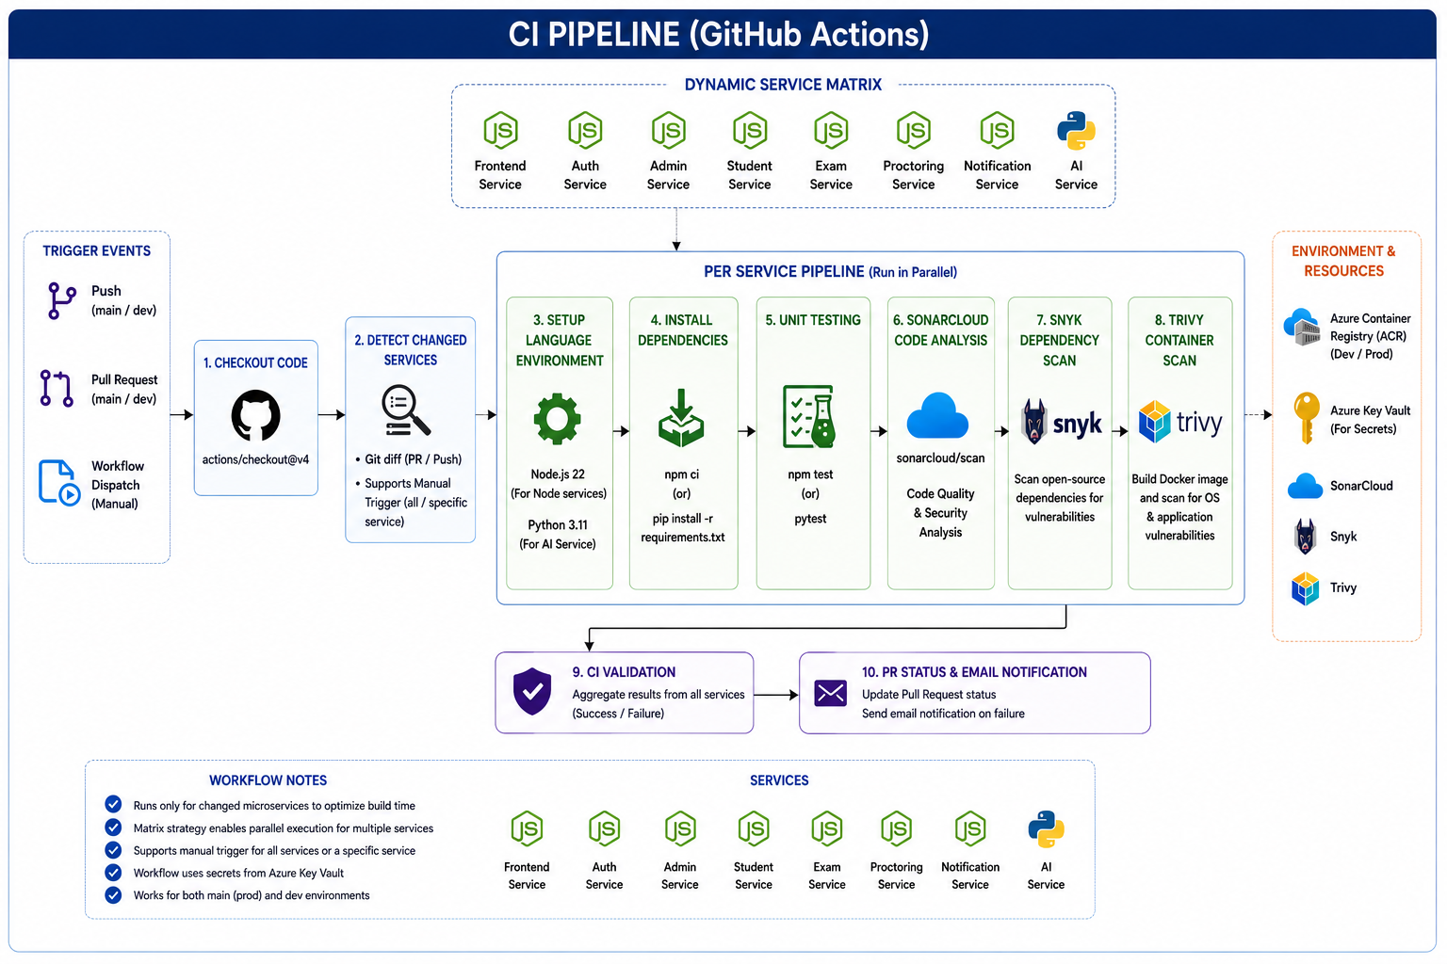

Slide 15
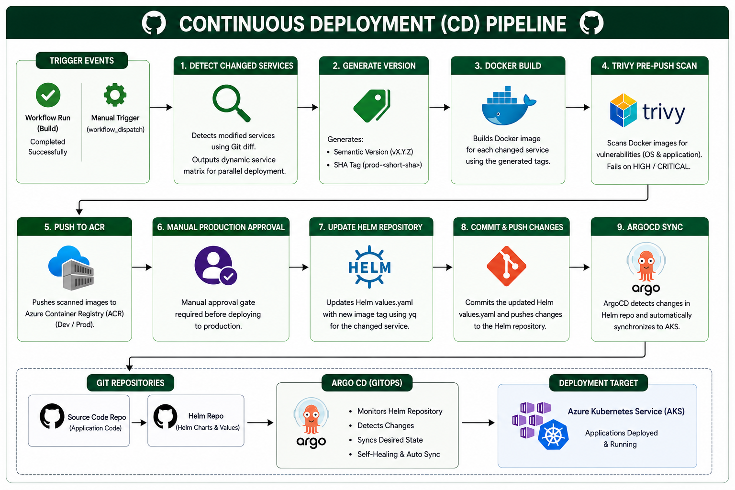

Slide 16
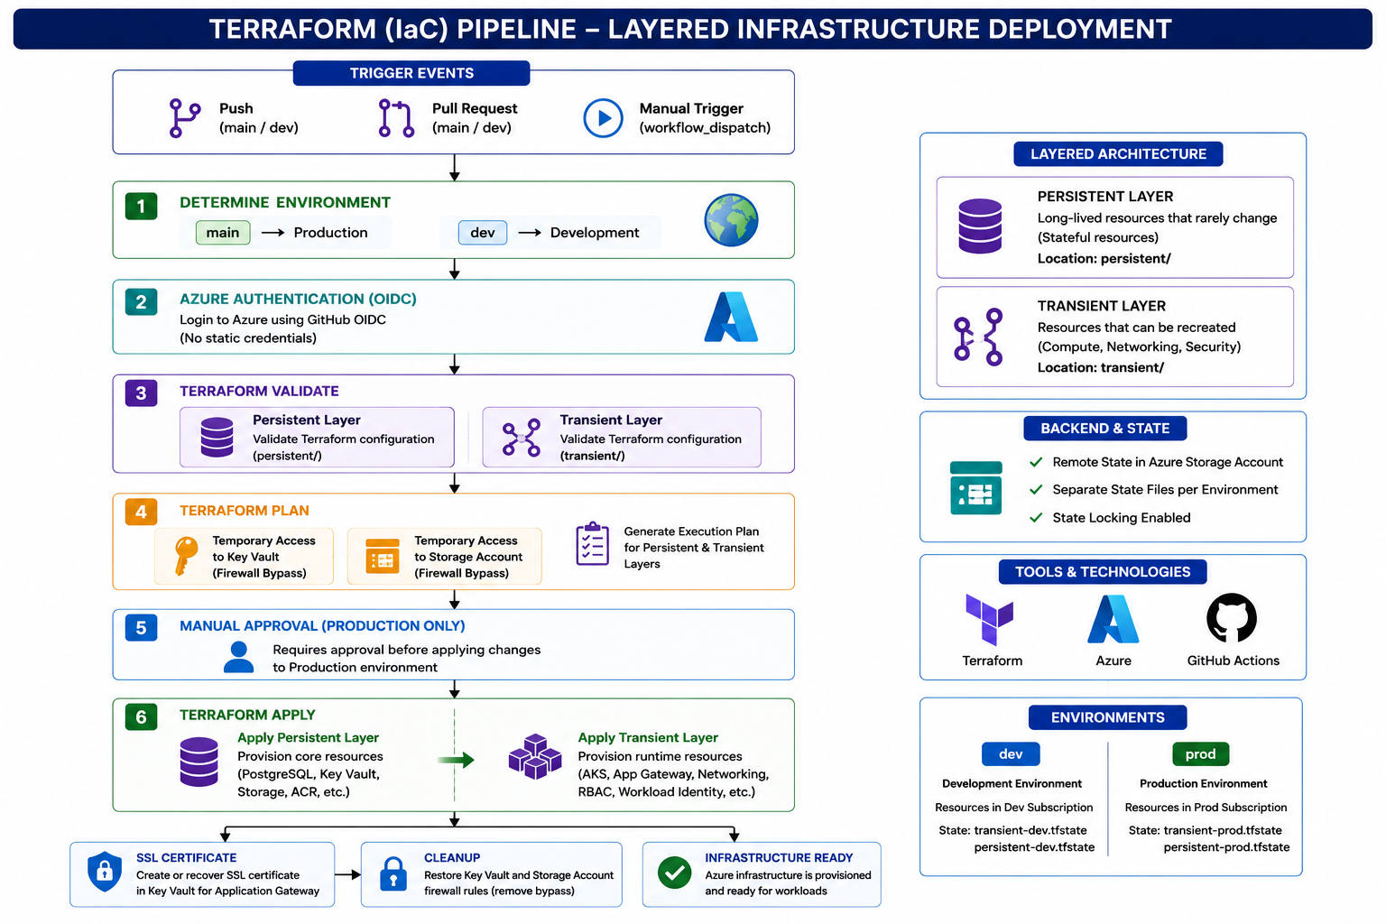

Slide 17
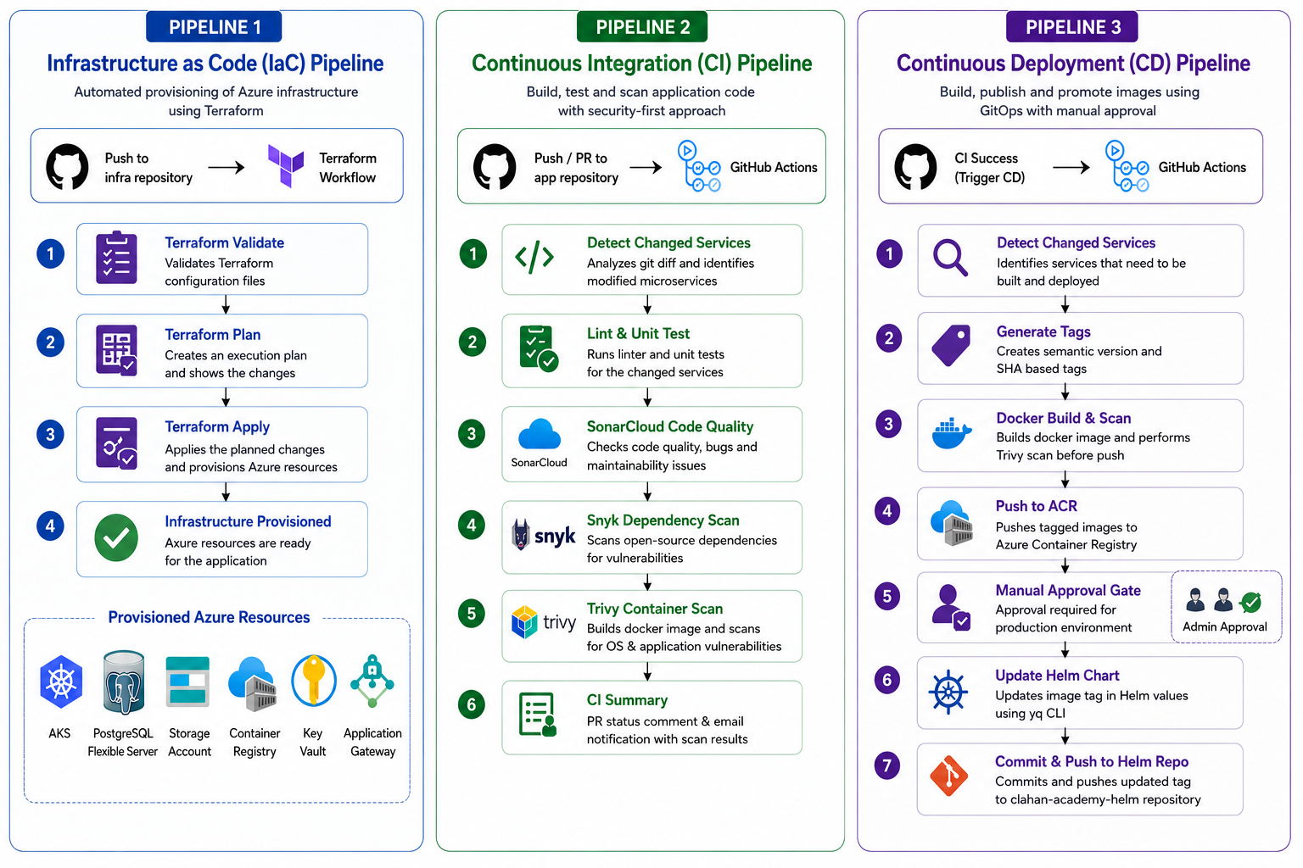

Slide 18

Microsoft Entra ID Workload Identity (Passwordless Pods)
AKS exposes an OIDC Issuer
Azure Kubernetes Service (AKS) provides an OpenID Connect (OIDC) identity provider for workloads running inside the cluster.
Entra ID creates User-Assigned Managed Identities
Dedicated Managed Identities are created for Clahan Academy microservices such as Auth Service, Exam Service, Student Service, and Notification Service.
Federated Credentials bind Service Accounts
Kubernetes Service Accounts are linked to Microsoft Entra ID identities using Federated Identity Credentials through Terraform.
Pods access Azure Services Passwordlessly
Pods exchange OIDC tokens for Azure access tokens and securely access Azure Key Vault and Azure Storage without secrets or access keys.

Slide 19
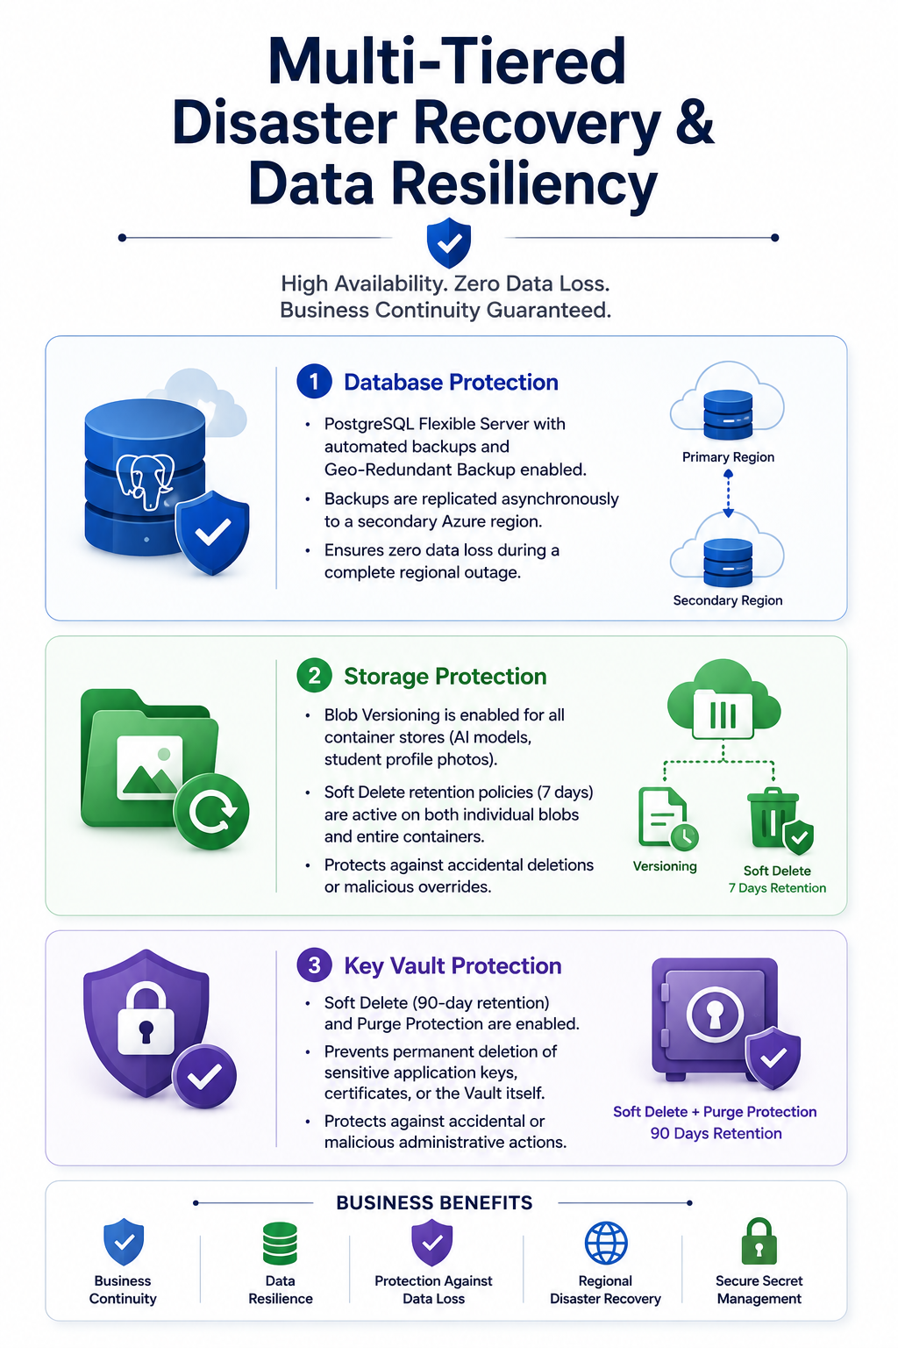
Multi-Tiered Disaster Recovery & Data Resiliency
Database Protection
PostgreSQL Flexible Server with Automated Backups and Geo-Redundant Backup Storage (GRS).
Backup copies are replicated to a secondary Azure region to ensure business continuity during regional failures.
Storage Protection
Azure Storage Accounts use Blob Versioning and Soft Delete.
Protects AI models, student documents, and profile data from accidental deletion or corruption.
Recovery retention period: 7 Days.
Security & Key Protection
Azure Key Vault configured with Soft Delete and Purge Protection.
Prevents permanent loss of secrets, certificates, and encryption keys.
Recovery retention period: 90 Days.

Slide 20



Observability: Prometheus, Grafana & Network Routing
Metrics: Prometheus scrapes AKS nodes, Kubernetes API, and pod metrics
Subdomain: Grafana dashboard is exposed via grafana.clahaanacademy.online
Routing: Envoy (kGateway) routes traffic to Grafana namespace. We updated the NetworkPolicy (gateway-netpol) to allow outbound traffic to the monitoring namespace

Slide 21
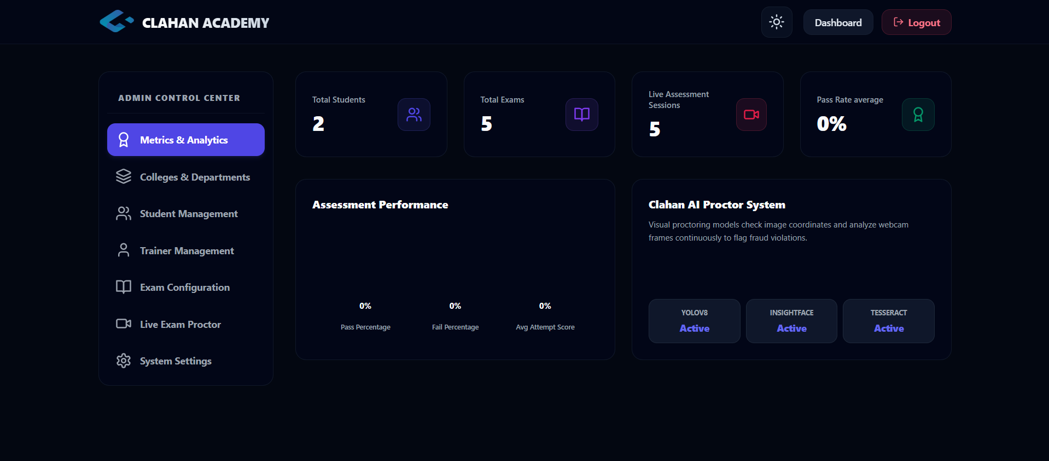

Slide 22
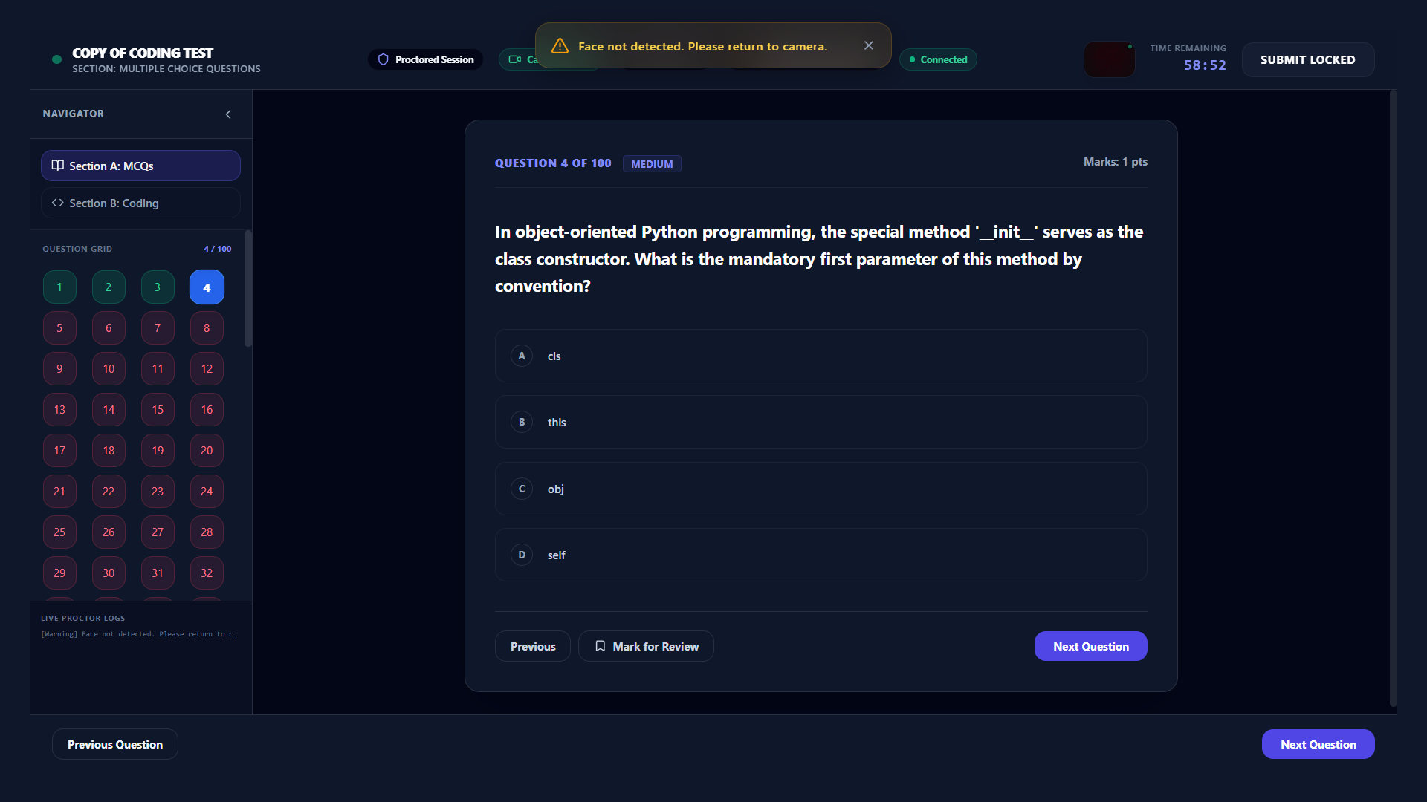

Slide 23
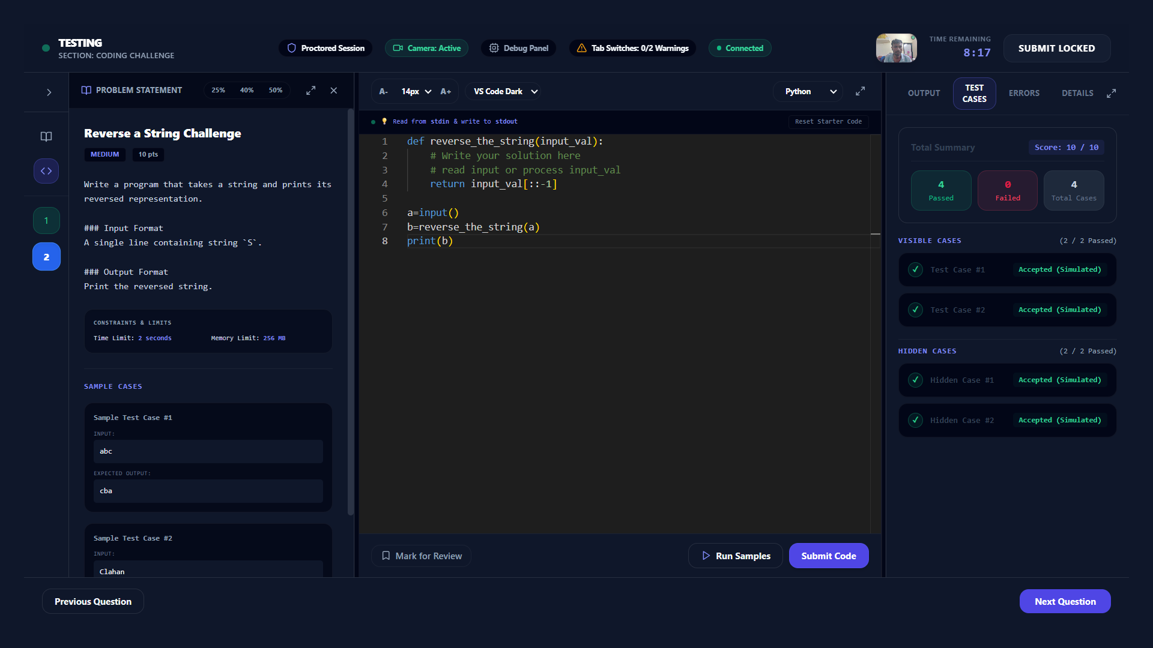

Slide 24
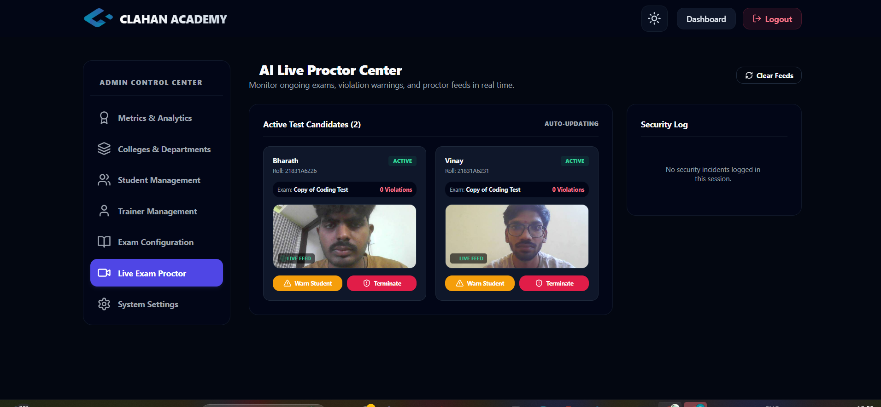

Slide 25
Thank You

